Slide 1
TASK MANAGEMENT
Using Asana
Data/Programming Team

Slide 2
Audience
You
Me
Everyone in this room

Slide 3
Materials
Task management
Task Lifecycle
The Eisenhower Decision Matrix
Task Management Tools
Why we use Asana

Slide 4
Task Management is paramount

Slide 5
Why you need to manage your tasks
Why is there a need for task management to be incorporated in our everyday work? To begin with, if you are like most people, you must have at least 25 individual tasks for you to take care of on any given day. Not all of these are of the same priority as the others.

Slide 6
Why you need to manage your tasks
In essence, task management is deemed very important among people because it helps us become more productive; it reduces the time allotted for setting priorities, encourages us to make use of the art of delegation, and enables us to differentiate from the four kinds of individual tasks which are: urgent and important, not urgent but important, urgent but not important, and not urgent and not important.

Slide 7
Why you need to manage your tasks
When you are faced with all these tasks day by day, it will not be surprising to know that you might have difficulty balancing your work, being unable to prioritize the ones that need immediate attention and those that you can simply get rid of. Because of this, many career-oriented individuals like you and i rely on proper task management to help them when it comes to prioritizing tasks.

Slide 8
Task Lifecycle

Slide 9
Task Lifecycle
The status of tasks can be described by the following states:
Ready
Assigned
Terminated
Expired
Forwarded
Finished
Failed

Slide 10
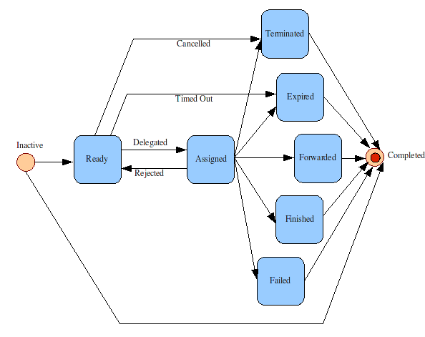

Slide 11
The Eisenhower Decision Matrix

Slide 12
Why you need to manage your tasks
To manage your tasks, the first thing you have to do is to make a list of your activities and individual tasks for the day. Ideally, you should spend 10 minutes for this. A very good thing about making a to-do list is that you can clear your mind of unnecessary worries brought about by thinking of how you can get everything done on time.

Slide 13
Task Management lessons from a president!
Eisenhower was the 34th President of the United States, serving two terms from 1953 to 1961. During his time in office, he launched programs that directly led to the development of the Interstate Highway System in the United States, the launch of the internet (DARPA), the exploration of space (NASA), and the peaceful use of alternative energy sources (Atomic Energy Act).

Slide 14
The Eisenhower Decision Matrix
Before becoming president, Eisenhower was a five-star general in the United States Army, served as the Supreme Commander of the Allied Forces in Europe during World War II, and was responsible for planning and executing invasions of North Africa, France, and Germany.
At other points along the way, he served as President of Columbia University, became the first Supreme Commander of NATO, and somehow found time to pursue hobbies like golfing and oil painting.

Slide 15
The Eisenhower Decision Matrix
Eisenhower had an incredible ability to sustain his productivity not just for weeks or months, but for decades. And for that reason, it is no surprise that his methods for time management, task management, and productivity have been studied by many people.
His most famous productivity strategy is known as the Eisenhower Box and it’s a simple decision-making tool that you can use right now. Let's talk about how to be more productive and how Eisenhower's strategy works.

Slide 16
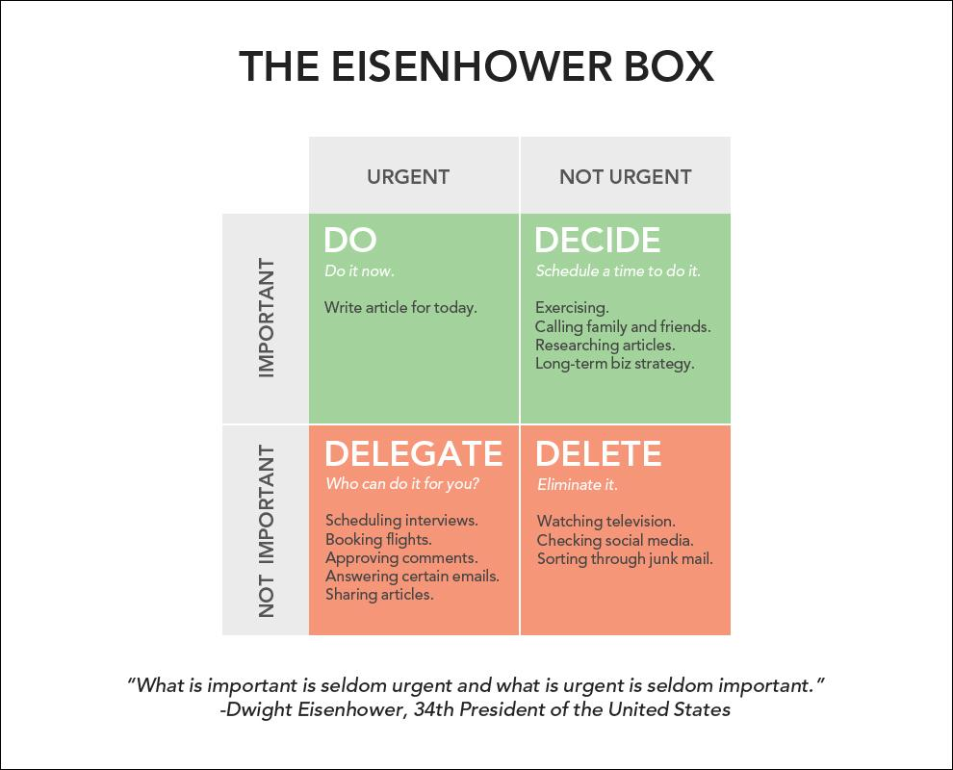

Slide 17
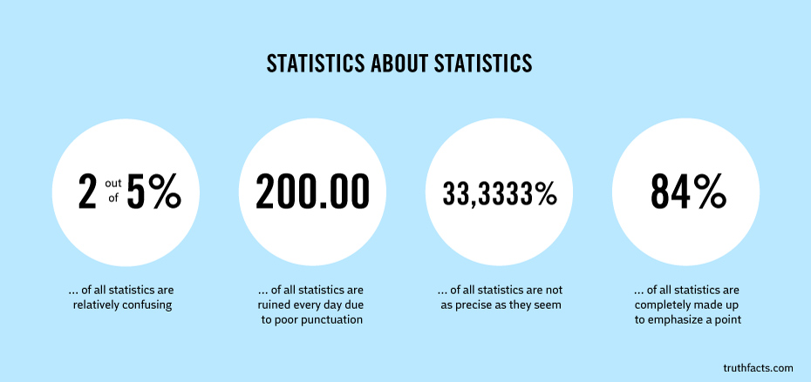
Random Fun Fact

Slide 18
Task Management Tools

Slide 19
Gets everything related to a job on one page, instantly makes collaboration easier, all updates are in real time.
Each to-do list functions as its own project, with tasks listed underneath the project hierarchy.
Trello offers a digital board to create, organize and prioritize actions.
Asana
Jira
Trello
Basecamp
Podio
Enterprise issue tracker; Creates user stories and issues, plan sprints, and distribute tasks across software team.
Basecamp organizes your projects, internal communications, and client work in one place so you have a central source of truth.

Slide 20
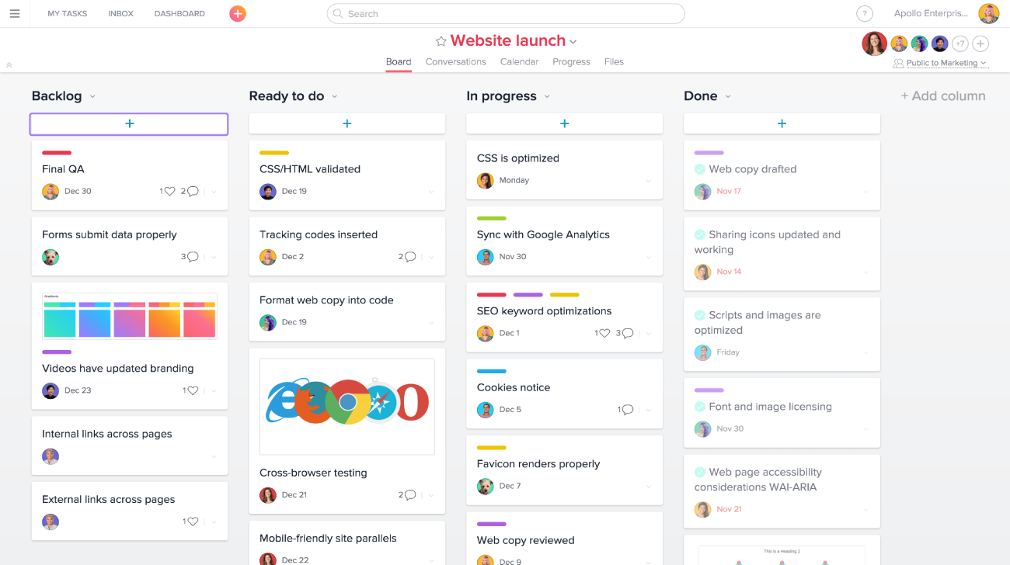

Slide 21
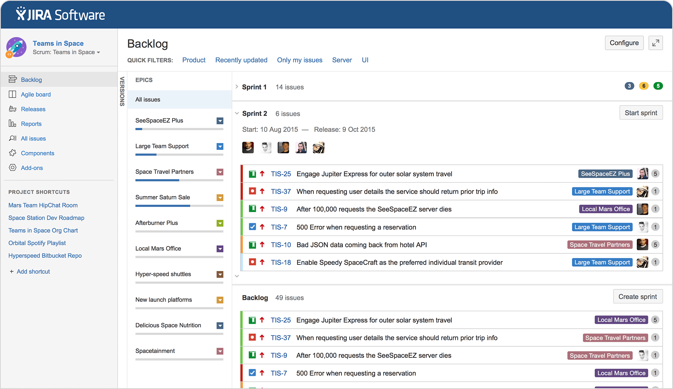

Slide 22
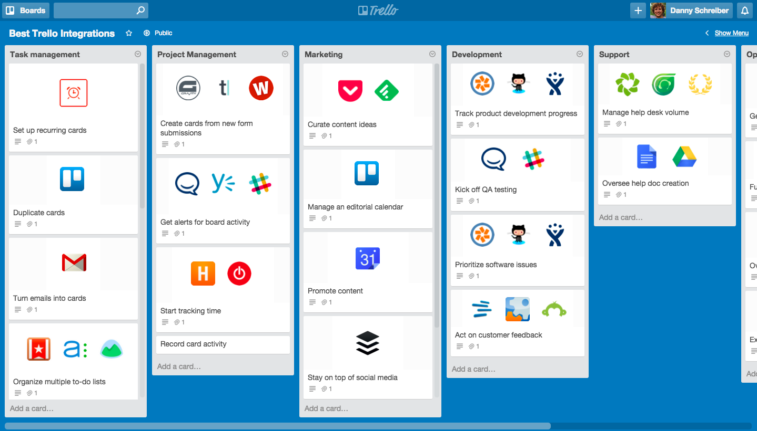

Slide 23
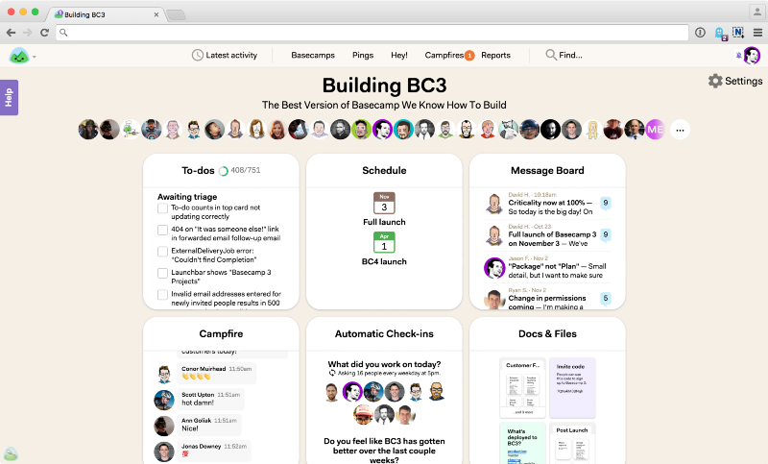

Slide 24
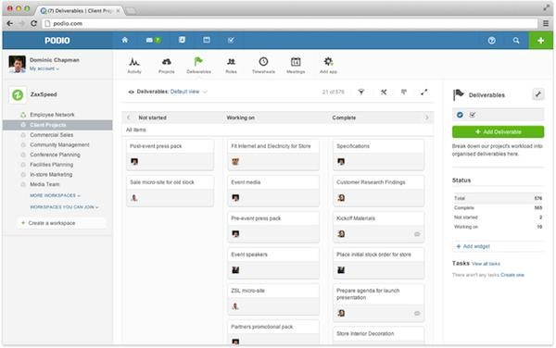

Slide 25
Our task-ship with Asana

Slide 26
Why we use Asana
To shed some background about this product’s roots, Asana was founded by Facebook co-founder Dustin Moskovitz and engineer Justin Rosenstein, after they both left Facebook in 2008.
Ultimately, we started using this application and found it useful, and we are therefore sharing our views

Slide 27
Random Fun Fact 2
Did you know that ‘asana’ is a yoga term that in direct translation means ‘seat’?
And here comes the common ground between a project management tool and a 1000-year-old spiritual tradition.
The Asana project manager is a work tool that allows you to be in a good place and get rid of hectic workflows, however heavy projects can be.

Slide 28

Random Fun Fact 2

Slide 29
The Structure
Basically, the Asana is structured into three shells:
Workspaces: The workspace is where you group various types of projects. For example, in business you might have workspaces labeled sales or marketing, which holds projects related to all the sales and marketing projects. Or, in your personal life, you might have Travel or Hobby workspaces, containing those relevant projects.

Slide 30
The Structure
Basically, the Asana is structured into three shells:
Projects: The projects area is where all your tasks are listed, grouped, tagged and prioritized.
Tasks: Tasks contain specific information about a task, such as due dates, tagging, responsibility assignment, notes, comments, sub-tasks, and more.

Slide 31
What is So great about Asana you ask?
Asana can be used directly through a web browser or its smartphone application. It’s free and you just need access to the internet. Asana is not great because of its robust features; it’s great because of it’s simplicity.
https://asana.com/

Slide 32
What is So great about Asana you ask?
Asana feels like an elegant and sophisticated upgrade from a notebook. It’s fast, intuitive, and easy to manipulate. The application responds and accepts input quickly and saves automatically.
Additionally, Asana’s taxonomy features and user interface make it easy to navigate, prioritize, and organize.

Slide 33
Why you should use Asana too : Associates
Let’s say have a project called "Project Opportunities" that serves as the master list of feature requests and suggestions from the entire team. Every so often, one of the associates can dive into this list, pick the best/most practical ideas, and add them to the road map and/or sprint plans. Other, lower priority but still enticing ideas might get tagged for "Polish Week."

Slide 34
Why you should use Asana too : Operations
You can use an Asana project for your internal communication, too. Staff and team announcements can be hosted within a project, keeping team members on the same page and allowing for internal discussions.
You can also log in items that need to be purchased in order of priorities.

Slide 35
Why you should use Asana too : PI’s
Most projects can be broken down into a set of tasks and milestones that need to be prioritized, completed in a certain order, by a certain date, and by a range of people.
In Asana, you can quickly build that set of tasks, use priority headings to group them into milestones (just add a ":" at the end of a task), then assign each task to the person owns it. For big tasks that require a number of steps (and/or different people) to complete, you can use subtasks.

Slide 36
Why you should use Asana too : HR
Managing HR processes can get smoother with Asana. Just create a template for onboarding new members or tracking of candidates in the process of interviews and hiring.

Slide 37
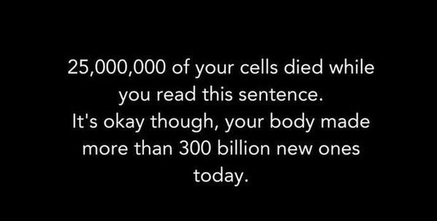
Random Fact : Three

Slide 38
Why you should use Asana too : PL’s
Tired of disorganized and unproductive meetings? You can create a recurring project for your monthly team meeting. Each team member can add tasks to it, so when it’s time to get together, you will have a complete meeting agenda.

Slide 39
Why you should use Asana too : Lab
How about making project launches and releases smoother? Just use a single project to coordinate the activities of different teams in your organization, so that you are all on the right track for the big day.

Slide 40
Why you should use Asana too : Analysts
You can also customize your own reports by clicking inside the search bar, and selecting Advanced Searchfrom the dropdown. From here, you have a multitude of ways to search for the criteria you’re looking for.
Check out Asana’s help article for detailed instructions on creating an Advanced Search.

Slide 41


